Slide 1
Expanding the Mission:
Fulfilling the Great Commission and Doing the Work of the Church

Slide 2
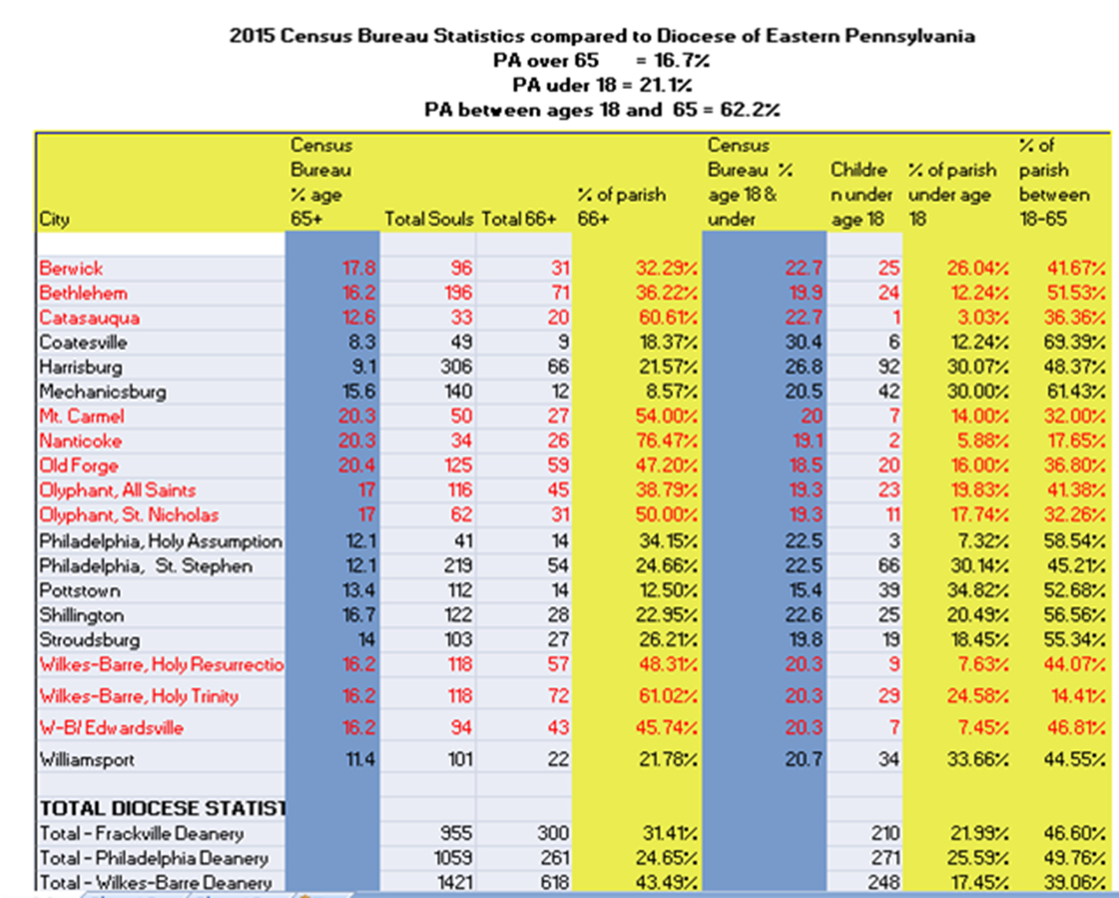
Correction Mt Carmel has 43.8% that are age 66+

Slide 3
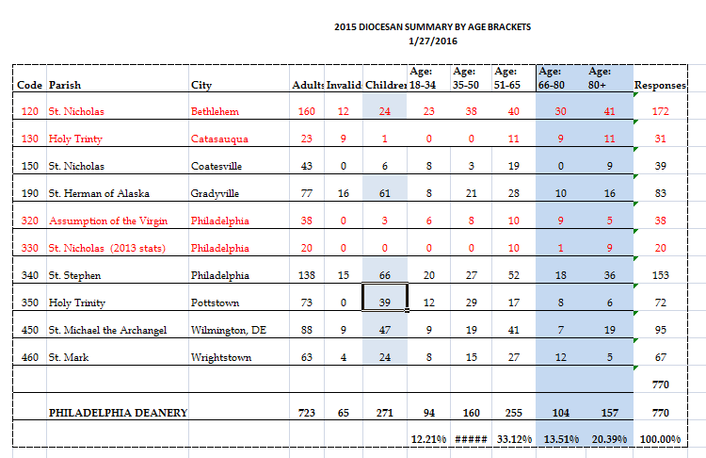
12.21% 20.78% 33.12% 13.51% 20.39% 100%

Slide 4
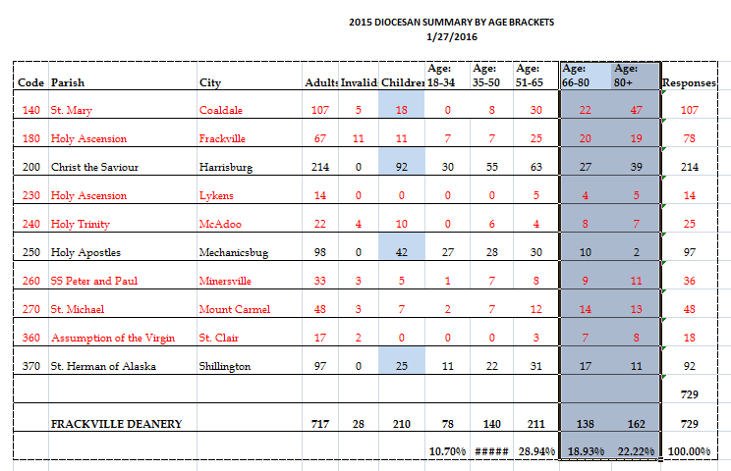
10.70% 19.20% 28.94% 18.93% 22.22%

Slide 5
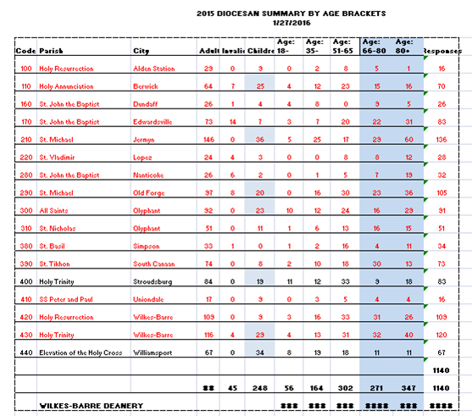
4.91% 14.39% 26.49% 23.77% 30.44% 100.00%

Slide 6
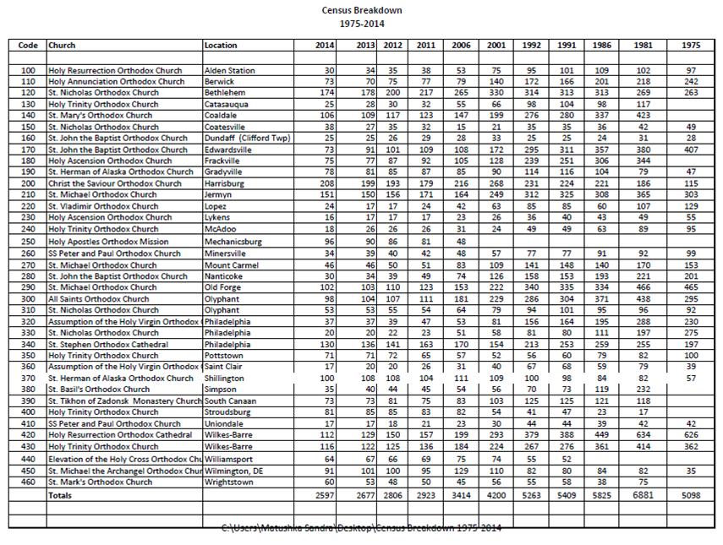

Slide 7
Archbishop Anastasios of Albania is correct when he writes.
“Church without mission is a contradiction in terms. If the Church is indifferent to the apostolic work with which she has been entrusted, she denies herself, contradicts herself and her essence, and is a traitor in the warfare in which she is engaged. A static Church which lacks vision and a constant endeavor to proclaim the Gospel to the oikoumene [“whole inhabited world”] could hardly be recognized as the one, holy, catholic and apostolic Church to whom the Lord entrusted the continuation of His work.”

Slide 8
Top Ten Ways Churches Drive Away First-time Guests
If you attend a church regularly, you’ve probably noticed the phenomenon. A guest shows up for a worship service, but he or she never returns. It is, unfortunately, a common issue in many churches.
I did a Twitter poll to ask these first-time guests why they chose not to return to a particular church. While some of the responses were anticipated, I admit being a bit surprised with some of them.
Though my poll is not scientific, it is nevertheless fascinating. Here are the top ten responses in order of frequency.
* Having a stand up and greet one another time in the worship service. This response was my greatest surprise for two reasons. First, I was surprised how much guests are really uncomfortable during this time. Second, I was really surprised that it was the most frequent response.
* Unfriendly church members. This response was anticipated. But the surprise was the number of respondents who included non-genuine friendliness in their answers. In other words, the guests perceived some of the church members were faking it. While many of our church’s perceive themselves as friendly, the real test is how the welcome their guests. Or do they ignore them? Say this seat is taken? Invite them to sit with us at coffee hour and engage them in conversation?

Slide 9
* Unsafe and unclean children’s area. This response generated the greatest emotional reactions. If your church does not give a high priority to children, don’t expect young families to attend. One church I have visited several times the stench of the bathroom was so strong, I could barely stay long enough to use it.
* No place to get information. If your church does not have a clear and obvious place to get information, you probably have lowered the chances of a return visit by half. There should also be someone to greet and assist guests at that information center as well.
Bad church website. Most of the church guests went to the church website before they attended a worship service. Even if they attended the service after visiting a bad website, they attended with a prejudicial perspective. The two indispensable items guests want on a website are address and times of service. It’s just that basic. We only have one chance to make a first impression and tell them what we are about. What does one learn about our church when they visit our parish website? Social Media, such as Facebook, Twitter and Instagram, are the best way to keep youth in the loop and remind them what is happening in the life of the parish.
* Poor signage. If you have been attending a church for a few weeks, you forget all about the signage. You don’t need it any more. But guests do. And they are frustrated when it’s not there. Times of service, phone number and web address are also helpful.
Insider church language. Most of the respondents were not referring to theological language as much as language that only the members know. My favorite example was: “The WMU will meet in the CLC in the room where the GAs usually meet.”
Boring or bad service. My surprise was not the presence of this item. The surprise was that it was not ranked higher.

Slide 10
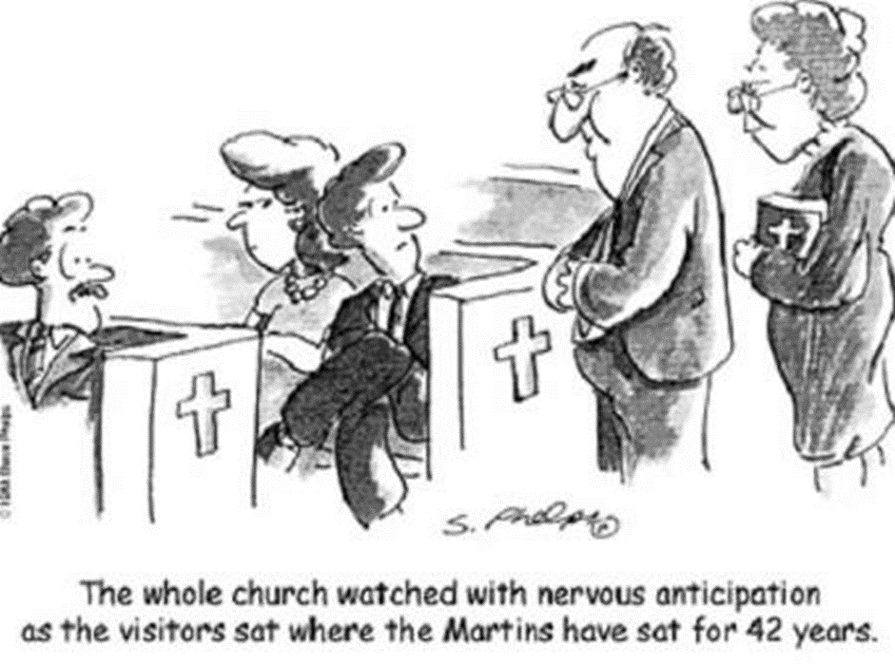
* Members telling guests that they were in their seat or pew. Yes, this obviously still takes place in some churches. This also takes place at coffee hour as well.
Dirty facilities. Some of the comments: “Didn’t look like it had been cleaned in a week.” “No trash cans anywhere.” Restrooms were worse than a bad truck stop.” “Pews had more stains than a Tide commercial.”
* There you have it. The top ten reasons first-time guests said they did not return to a church. I can’t wait to hear from you readers. You always have such good additions and insights. By Tom Rainer. Tom Rainer has excellent commentary on church growth. Check out his website.

Slide 11
We cannot exclude others based on cultural or ethnic differences and call ourselves the Church, much less Christian. The Church is called to take the Gospel to every land and people and find a way to express the faith in that culture. Cyril and Methodius did not force Greek customs and language on the Slavs. The Slavs did not force Russian Culture, customs and language on the native Alaskans. There always has to be a synthesis.
We have to be Faithful to the Gospel, but express it in a manner that is culturally meaningful. The Orthodox Church is not here to make them Russians, Greeks, Arabs, Romanians, Bulgarians, Georgians, etc. We are here for the sole purpose of proclaiming the Gospel of Jesus Christ and making His disciples.

Slide 12
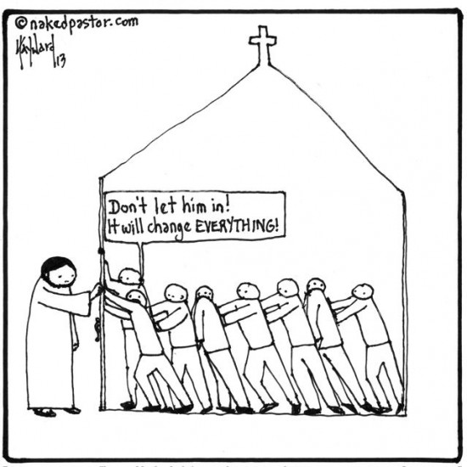
The FACT that this cartoon is so applicable across the board in many churches, regardless of the flavor, speaks volumes of how widespread the problem is.
At a non-OCA Orthodox Church’s Animal Meeting the usual bickering and bullying was taking place. A reader stood up and read the words of Christ, seeking direction for the church . . . . What do you think the response was?

Slide 13
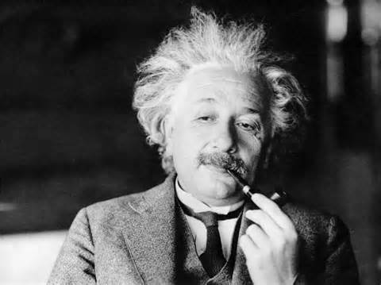
The Definition of INSANITY
“The definition of insanity is to keep doing the same thing over and over again and expecting a different result.

Slide 14
Autopsy of a Deceased Church:
11 Things I Learned
I was their church consultant in 2003. The church’s peak attendance was 750 in 1975. By the time I got there the attendance had fallen to an average of 83. The large sanctuary seemed to swallow the relatively small crowd on Sunday morning.
The reality was that most of the members did not want me there. They were not about to pay a consultant to tell them what was wrong with their church. Only when a benevolent member offered to foot my entire bill did the congregation grudgingly agree to retain me.
I worked with the church for three weeks. The problems were obvious; the solutions were difficult.
On my last day, the benefactor walked me to my rental car. “What do you think, Thom?” he asked. He could see the uncertainty in my expression, so he clarified. “How long can our church survive?” I paused for a moment, and then offered the bad news. “I believe the church will close its doors in five years.”
I was wrong. The church closed just a few weeks ago. Like many dying churches, it held on to life tenaciously. This church lasted ten years after my terminal diagnosis.
My friend from the church called to tell me the news. I took no pleasure in discovering that not only was my diagnosis correct, I had mostly gotten right all the signs of the impending death of the church. Together my friend and I reviewed the past ten years. I think we were able to piece together a fairly accurate autopsy. Here are eleven things I learned.
* The church refused to look like the community. The community began a transition toward a lower socioeconomic class thirty years ago, but the church members had no desire to reach the new residents. The congregation thus became an island of middle-class members in a sea of lower-class residents. We cannot exclude people because of race, socio-economic status, etc. “For God so loved the World, that He gave His only Begotten Son, that whoever would believe upon Him would be saved.”

Slide 15
The church had no community-focused ministries. This part of the autopsy may seem to be stating the obvious, but I wanted to be certain. My friend affirmed my suspicions. There was no attempt to reach the community. Christ commanded Hos Disciples to “go into all the world and make disciples of every nation and teach them to observe all that he had commanded them, baptizing them in the name of the father, the Son, and the Holy Spirit.” Do we see our priest as only the priest for our parish or for the community at large?
Members became more focused on memorials. Do not hear my statement as a criticism of memorials. Indeed, I recently funded a memorial in memory of my late grandson. The memorials at the church were chairs, tables, rooms, and other places where a neat plaque could be placed. The point is that the memorials became an obsession at the church. More and more emphasis was placed on the past.
* The church had no community-focused ministries. This part of the autopsy may seem to be stating the obvious, but I wanted to be certain. My friend affirmed my suspicions. There was no attempt to reach the community.
Members became more focused on memorials. Do not hear my statement as a criticism of memorials. Indeed, I recently funded a memorial in memory of my late grandson. The memorials at the church were chairs, tables, rooms, and other places where a neat plaque could be placed. The point is that the memorials became an obsession at the church. More and more emphasis was placed on the past.*
The percentage of the budget for members’ needs kept increasing. At the church’s death, the percentage was over 98 percent.
* There were no evangelistic emphases. When a church loses its passion to reach the lost, the congregation begins to die.
* The members had more and more arguments about what they wanted. As the church continued to decline toward death, the inward focus of the members turned caustic. Arguments were more frequent; business meetings became more acrimonious.
* With few exceptions, pastoral tenure grew shorter and shorter. The church had seven pastors in its final ten years. The last three pastors were bi-vocational. All of the seven pastors left discouraged.
* The church rarely prayed together. In its last eight years, the only time of corporate prayer was a three- minute period in the Sunday worship service. Prayers were always limited to members, their friends and families, and their physical needs.

Slide 16
* The church had no clarity as to why it existed. There was no vision, no mission, and no purpose.
* The members idolized another era. All of the active members were over the age of 67 the last six years of the church. And they all remembered fondly, to the point of idolatry, was the era of the 1970s. They saw their future to be returning to the past.
* The facilities continued to deteriorate. It wasn’t really a financial issue. Instead, the members failed to see the continuous deterioration of the church building. Simple stated, they no longer had “outsider eyes.”
Though this story is bleak and discouraging, we must learn from such examples. As many as 100,000 churches in America could be dying. Their time is short, perhaps less than ten years.
What do you think of the autopsy on this church? What can we do to reverse these trends?

Slide 17
Six Things Growing Churches Do
That Others Don’t
Ninety percent of the churches in the United States today are stagnant or declining.
Dying churches are closing their doors at the rate of ten per day. Even church members who have been dedicated to the church for years are attending church less than ever before.
It would be easy to throw up our hands in frustration with church growth and give up, but perhaps there’s a glimmer of hope. If ninety percent of churches aren’t growing, that means there’s ten percent that are. Which leads me to two conclusions, either God is choosing to bless these churches over the others, or these churches are doing something the other churches are not.
I’ve been in dying churches, and I’ve been in growing churches. And I choose to believe the later. They look quite different from each other. Here are six differences.
1. Growing Churches are Outsider Focused
Growing churches focus on those outside the church. The Pastor speaks a message each week that appeals to those who don’t know Christ. Every ministry in the church puts a high priority on guests. Church events are geared towards reaching those in the community who don’t attend a church. The church budget is geared around evangelism. Discussions revolve around the best way to reach those far from Christ.
Dying churches focus on those inside the church. The Pastor speaks a message to the congregation each week with little thought of guests. Ministries in the church place a high priority on serving those inside the church. Church events are geared towards fellowshipping with one another. The church budget is geared towards keeping members happy. Discussions revolve around the color of the carpet.

Slide 18
Growing Churches are Staff Led
In growing churches, the Senior Pastor is allowed to lead and make decisions based on the vision God has given him for the church. The Senior Pastor is allowed to hire his own staff as the budget allows. The Senior Pastor decides what ministries to add and what ministries to cut. The Senior Pastor decides what events should take place and which shouldn’t. A Pastor searches for the lost sheep.
In dying churches the church or church board lead and make decisions. The church or board nominate and approve any hires made. The church or board decides what ministries should be funded and which shouldn’t. The church or board decides what events should take place and which shouldn’t. In a dying church, the Pastor only has as much authority as the church or board chooses to give him. Basically, is the priest simply a Chaplain for a closed community?
Growing churches value innovation over tradition.
Growing churches are innovative churches. They are always seeking out new ways to reach the communities they serve. They leverage technology for the benefit of the Gospel. Growing churches have a strong online presence through their website and social media accounts such as Facebook, Twitter, and Instagram. Innovative churches believe the best way to make disciples is through community, so they embrace small groups. This does not mean we change our Faith or Holy Tradition, but we may need to adjust the manner in which we communicate it. The Church has always found ways to express the One Faith in various cultures. Cultures do change. Russian culture is not what it was 100 years ago, 50 years ago or 30 years ago. The same could be said for the U.S.A.
Dying churches are churches so rooted in tradition they refuse to change. They are always seeking out ways to preserve what has already been established. They fear technology and believe it’s a danger to the Gospel. Dying churches have little to no online presence. They believe the best way to make disciples is in a classroom, so they embrace class settings such as Sunday School. Local customs of the historical Orthodox Church should never become an obstacle to the Gospel, as they are the packaging and not the content.

Slide 19
Growing Churches have a bias toward action.
Growing churches get things done. They’re not satisfied with just talking about problems and opportunities. They do something about them. Growing churches are willing to make decisions that benefit the church, even though it may hurt some feelings. They’re not satisfied with waiting for those far from Christ come to them. They go out into the communities to reach people right where they are.
Dying churches talk about getting things done but never actually act. They talk about the same problems and opportunities over and over again but never do anything about them. Dying churches refuse to make hard decisions that may hurt someone’s feelings, even though it would benefit the church. They’re satisfied with who’s already in church and refuse to reach out to those outside the church. As a priest I was told we don’t have room for anymore people, i.e., people new to the faith. I was told to contact those who were there people who had fallen away. When I did they then said the person was a trouble maker and wasn’t welcome.
Growing Churches Celebrate Well
Growing churches gather together to celebrate what God is doing in their church and community. There’s always a sense of excitement of what God may do next. Because of this people are hesitant to miss church. People are excited to serve and give back to the church because they see how it’s leading to life change. Smiles, handshakes, and hugs are frequently seen in a church that celebrates. PEOPLE EXPECT THE EXPERIENCE OF THE LORD’S PRESENCE TO CHANGE THEIR LIVES!
Dying churches gather together out of obligation. There’s never a sense of excitement about what God may do, so people don’t think twice about missing church. Most people refuse to serve or give back to the church because they never see how it’s impacting lives. Dying churches don’t have time for smiles, handshakes, and hugs because most people are looking to leave church as fast as possible.

Slide 20
Growing Churches have faith in God.
Growing churches believe God can do something great through their church. They embrace risk and take chances to advance the Gospel. They believe God is with them and through Him they can accomplish things that look impossible. Growing churches have meetings that are filled with ideas on how they can accomplish the vision God has given them. GROWING CHURCHES ARE MISSION MINDED WITH A DESIRE TO DO THE WORK OF THE CHURCH.
Dying churches believe God has forgotten them. Maybe there was a time when God did something great in their church, but that was a long time ago. They avoid risk at all costs and never take chances. They allow fear to control their decisions. Dying churches forget that God is with them, and so everything looks impossible to them. Their meetings are filled with excuses on why they can’t do something.
If you serve in a dying church, there is hope. You may have forgotten God, but God has not forgotten you. The good news is the God we serve specializes in bringing the dead back to life, and that may be just what your church needs.
Travis Stephens is a husband, father, and executive pastor of a small town church that grew large. He has a passion for helping small town churches and pastors. So most of what he writes about focuses on helping churches and ministry leaders take steps to grow themselves and the churches they serve. Learn more athttp://travisstephens.me

Slide 21
The Scandal of Biblical Illiteracy: It’s our Problem, by Albert Mohler
We will not believe more than we know, and we will not live higher than
We will not believe more than we know,
and we will not live higher than our beliefs!
America’s evangelical Christians are rightly concerned about the secular worldview’s rejection of biblical Christianity; we ought to give some urgent attention to a problem much closer to home–biblical illiteracy in the church. This scandalous problem is our own, and it’s up to us to fix it.
Researchers George Gallup and Jim Castelli put the problem squarely: “Americans revere the Bible–but, by and large, they don’t read it. And because they don’t read it, they have become a nation of biblical illiterates.” How bad is it? Researchers tell us that it’s worse than most could imagine.
Fewer than half of all adults can name the four gospels. Many Christians cannot identify more than two or three of the disciples. According to data from the Barna Research Group, 60 percent of Americans can’t name even five of the Ten Commandments. “No wonder people break the Ten Commandments all the time. They don’t know what they are,” said George Barna, president of the firm. The bottom line? “Increasingly, America is biblically illiterate.” [see Barna Group’s web site]
Multiple surveys reveal the problem in stark terms. According to 82 percent of Americans, “God helps those who help themselves,” is a Bible verse. Those identified as born-again Christians did better–by one percent. A majority of adults think the Bible teaches that the most important purpose in life is taking care of one’s family.
Some of the statistics are enough to perplex even those aware of the problem. A Barna poll indicated that at least 12 percent of adults believe that Joan of Arc was Noah’s wife. Another survey of graduating high school seniors revealed that over 50 percent thought that Sodom and Gomorrah were husband and wife. A considerable number of respondents to one poll indicated that the Sermon on the Mount was preached by Billy Graham. We are in big trouble.

Slide 22
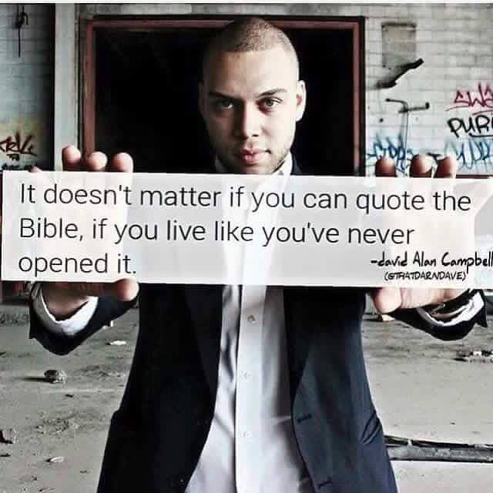
There are a plethora of articles online about Biblical Illiteracy. There was even one addressing the ignorance of the Bible by evangelical television preachers.
Just because one may quote Scripture does not mean they understand it.
Scripture is in the understanding, not in the reading.
Years ago, when Fr Georges Florovsky wrote, Bible, Church and Tradition, he spoke of the lost Scriptural Mind.
Scripture is a core part of OUR TRADITION

Slide 23
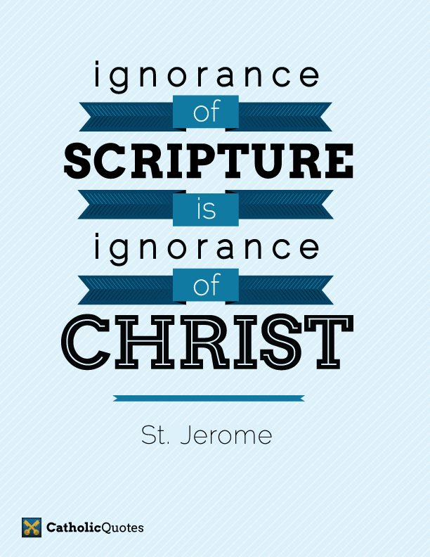

Slide 24
We profess to be the true Faith!
Are we able to answer questions about our faith?
If we have a prayer corner like Baba had, with a prayer book, incense burner,
Holy Water, Blessed Oil, a Bible, and a Prayer List.
Do we actually use it?
Have we merely preserved the trappings of our Faith and neglected the CONTENT?
If we have not read through the Bible,
Cannot explain the Creed
Do not know that we believe Christ was raised bodily as will His Saints.
We have neglected the content of our FAITH.
How can we assume leadership positions of a Church if we do not know and practice our faith or
The MISSION of the Church?

Slide 25
Secularized Americans should not be expected to be knowledgeable about the Bible. As the nation’s civic conversation is stripped of all biblical references and content, Americans increasingly live in a Scripture-free public space. Confusion and ignorance of the Bible’s content should be assumed in post-Christian America.
The larger scandal is biblical ignorance among Christians. Choose whichever statistic or survey you like, the general pattern is the same. America’s Christians know less and less about the Bible. It shows.
How can a generation be biblically shaped in its understanding of human sexuality when it believes Sodom and Gomorrah to be a married couple? No wonder Christians show a growing tendency to compromise on the issue of homosexuality. Many who identify themselves as Christians are similarly confused about the Gospel itself. An individual who believes that “God helps those who help themselves” will find salvation by grace and justification by faith to be alien concepts.
Christians who lack biblical knowledge are the products of churches that marginalize biblical knowledge. Bible teaching now often accounts for only a diminishing fraction of the local congregation’s time and attention. The move to small group ministry has certainly increased opportunities for fellowship, but many of these groups never get beyond superficial Bible study.
Youth ministries are asked to fix problems, provide entertainment, and keep kids busy. How many local-church youth programs actually produce substantial Bible knowledge in young people?
Even the pulpit has been sidelined in many congregations. Preaching has taken a back seat to other concerns in corporate worship. The centrality of biblical preaching to the formation of disciples is lost, and Christian ignorance leads to Christian indolence and worse.

Slide 26
This really is our problem, and it is up to this generation of Christians to reverse course. Recovery starts at home. Parents are to be the first and most important educators of their own children, diligently teaching them the Word of God. [See Deuteronomy 6:4-9.] Parents cannot franchise their responsibility to the congregation, no matter how faithful and biblical it may be. God assigned parents this non-negotiable responsibility, and children must see their Christian parents as teachers and fellow students of God’s Word.
Churches must recover the centrality and urgency of biblical teaching and preaching, and refuse to sideline the teaching ministry of the preacher. Pastors and churches too busy–or too distracted–to make biblical knowledge a central aim of ministry will produce believers who simply do not know enough to be faithful disciples.
We will not believe more than we know, and we will not live higher than our beliefs. The many fronts of Christian compromise in this generation can be directly traced to biblical illiteracy in the pews and the absence of biblical preaching and teaching in our homes and churches.
This generation must get deadly serious about the problem of biblical illiteracy, or a frighteningly large number of Americans–Christians included–will go on thinking that Sodom and Gomorrah lived happily ever after.
http://www.albertmohler.com/?p=37602
Examples: What we believe about the resurrection, reincarnation, etc.

Slide 27
Millenials
are those born around 1981 and after. They are distinct in a variety of ways. They expect something to be what it says it is. They want authenticity and substance. They are a generation that realizes that America is no longer the melting pot it once was, and they want nothing to do with any form of prejudice or exclusivity.
If we say we are a Church, they expect us to behave as we teach. Duplicity does not fly. They watch our actions as closely as our words.
If we are the Church which preaches, teaches and sings about the Lord’s desire for all mankind to be saved. Therefore closed communities and racial prejudice are anathema to them.
They expect that a Church would be engaged in the work of the Church, i.e., missions, evangelism and discipleship.
The Article below is an open letter in response to entertainment oriented churches, but there are also insights we may benefit from if we want the younger generation to return to the fold.
Dear Church: An open letter from one of those millennials you can’t figure out
May 13, 2015 by Jonathan Aigner 361 Comments
A lot’s been made over the millennial generation and their religious life. Why they go to church. Why they don’t go to church. What they want. What they hate. I’m going to do something different here. I’m not going to cite Barna. I’m not going to quote Rachel Held Evans. I’m not going to link to any articles or blog posts. I’m just going to tell you what’s true for me, and what I’ve seen to be true of others like me.

Slide 28
I am one of those rascally millennials, by the way. One of those enigmatic, paradoxical, media-dependent, coffee-drinking young people swept together under this millennial umbrella. Except coffee tears up my stomach, so I dropped that stuff. I was born when a former actor was in the White House. I was crushed the day slap bracelets were banned from my elementary school. I remember hiding in my room with my five-inch TV to watch Friends and Seinfeld and the Simpsons, and all the other shows I wasn’t allowed to see. I don’t remember what it’s like to not have a home computer. I can barely recall a time before cell phones. I’ve never left home without one.
I’ve always been in church. I’ve never left, though I’ve come close several times. I would have left in high school if I’d had the option, but in my house, attendance at my cool, hip, contemporary-worshiping, youth-group-glorifying, moralism-preaching, theology-eschewing McCongregation was a non-negotiable.
So I went. Through every repetition of “Shout to the Lord,” every True Love Waits commitment ceremony, every rapture-ready dispensationalist Bible study, every sermon series on how to make myself into a good, moral, well-behaved person so that I wouldn’t tick off God and bring condemnation to America.
But I was always a misfit. Always a skeptic. Always a doubter. Always an outsider. Today, you’re my livelihood, and putting food on my table overcomes the gravitational pull of my mattress on a cold, rainy Sunday morning. Or a hot, dry one. Or any other one. But that pull is still there. It’s always been there. It’s never left.
The truth is, my relationship with you is still love-hate.
I love the theology, but I hate the expectations of pseudo piety.

Slide 29
Love the gospel, hate the patriotic moralism.
Love the Bible, hate the way it’s used.
Love Jesus, but hate what we’ve done with him.
Love worship, but hate Jesusy entertainment.
And those other kids I went to church with, I’ve come to find that many of them were misfits, skeptics, and doubters, too. Some of them still go, but more of them have left. Some of them left because they had no desire to conform to an outdated cultural norm that demanded we keep up appearances by parking our butts in our regular Sunday pew. They didn’t believe, and didn’t believe they needed to pretend that they did. Others have left because they grew keen to the bait-and-switch tactics. They’ve left because they didn’t fit in, and couldn’t pretend anymore. They left because the Jesus preached from the pulpit didn’t look much like the Jesus of Nazareth. They left because all the bells and whistles and hooks and marketing rang hollow.
They left because they had been constantly catered to, constantly kept busy, but had never been taught how to be a part of the church. The programs won’t bring them back. The coffee won’t bring them back. The show – the lights, fog machine, the contemporary worship that we think is essential - nope, that won’t do it, either.
But here are a few things that might just work with some of us. They may seem crazy. They may contradict everything you’ve heard. But, as one of these millennials, this is what would work for me, and for a lot of the people I know who have left.

Slide 30
Don’t expect a “worship style” to do your dirty work. Contemporary worship hasn’t worked. The longer we extend the life of this failed experiment, the more we see the results. In my experience, contemporary worship brings in three groups. Baby boomers who are still stuck in their rebellion against the establishment, parents who mistakenly think that contemporary worship is the only way for their kids to connect to the church, and a small percentage of young adults who’ve never left and who never knew anything other than contemporary worship.
In modeling worship after commercial entertainment, you’ve compromised your identity, and we’re still not coming back. And even if we did, would there be any church left? Would there be anything beyond the frills, the lights, the performance, the affected vocals? Would we still see a cross? Would we still find our place among the saints who have come before? Would we find reminders of our life-long need of grace? Or would we have been hooked by something altogether different? Would we merely find your answer key for the great mystery of faith?
Don’t give us entertainment, give us liturgy. We don’t want to be entertained in church, and frankly, the church’s attempt at entertainment is pathetic. Enough with the theatrics. Enough with the lights, the visuals, the booming audio, the fog machine, the giveaway gimmicks, the whole production. Follow that simple yet profound formula that’s worked for the entire history of the church. Entrance, proclamation, thanksgiving, sending out. Gathering, preaching, breaking bread, going forth in service. Give us a script to follow, give us songs to sing, give us the tradition of the church, give us Holy Scripture to read. Give us sacraments, not life groups, to grow and strengthen us.

Slide 31
Week after week, season after season, year after year, let us participate in the drama of the gospel. It’s not supposed to be fun. It’s not supposed to produce intense emotional response. It’s a microcosmic, disciplined, anticipatory remembrance of who we were, who we are, and who we are to be. We need this. We need these heartfelt rituals in our lives to keep us returning to the fount of grace, to mark our way back home. Be yourself, and you just might shake us out of our technology-induced, entertainment-craving slumber. Keep giving us Jesusy versions of mainstream entertainment, and there’s no hope. You can’t compete. You’ll lose every time.
Don’t target us. In doing so, you’ve marketed and advertised yourself into oblivion. We’re left with homogeneous congregations of approximately the same ages and backgrounds who are just there for what they can get out of the church. No wonder we’ve left. Just be the church. Be yourself. Use your regular old liturgy. Offer your regular old sacraments. Sing your regular old songs. Cast a wide net, and let whosoever will come. Trust me, we’re more likely to show up when we don’t feel like fish snapping up the bait.
Be inclusive. Tear down silos. Save us from ourselves. We don’t need more youth group lock-ins, more Sunday School options for each age group, more senior adult outings on beekeeping and genealogy. We need more of each other. We need to look into the faces of old and young, rich and poor, of different colors, races, and ethnic backgrounds, so we can learn to see Jesus in faces that don’t look like us. So we can remember that the kingdom is bigger than our safe, suburban bubble. That’s right, we need community, not bound together by age or economic status or skin color, but wrought with the hammering of nails on a wooden cross. Our internet connectivity is just fine. The rest of our lives is a different story. We are hopelessly disconnected. Church, you can be a powerful remedy if you stop posing as a Fortune 500 company scheming to sell a product.

Slide 32
Welcome the toughest, deepest, grittiest, most desperate, most shocking questions. We have lots of questions. More and more, what we see in the world doesn’t jive with what we grew up hearing from the pulpit. You have done more damage by requiring politeness, by refusing to engage, by brusquely rebuking honesty and vulnerability. You’re better than that, church. At least you should be. You should be a safe place for struggling, grappling, doubting.
Allow us to be real with each other, to avoid the temptation to gloss over the crap going on around us with easy, tidy, Jesusy clichés‘. You’ve always taught us how the world is black and white, just like The Andy Griffith Show and I Love Lucy. But, and excuse us for noticing, the world is mostly gray, gray like Ricky Ricardo’s dinner jacket and Barney Fife’s nightstick. Let’s embrace that grayness together.
So no more three points and a take home. No more self-help. No more marriage and parenting advice. No more anger management pointers. We don’t need you to be our therapist, we need you to be our church. We need you to grapple with us, to push back. We need you to show us how to be the hands and feet of Christ, to struggle with us in making it more on earth as it is in heaven.
It’s not too late, church, but your tactics aren’t working.
It’s time for a new strategy.
It’s time to be uncool. To be radical. To be different.
It’s time to be yourself. Your Friend, Jonathan

Slide 33
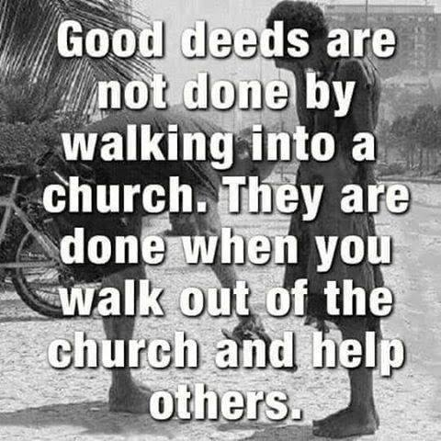

Slide 34
Sermons We See
Edgar Guest
"I'd rather see a sermon
than hear one any day;
I'd rather one should walk with me
than merely tell the way.
The eye's a better pupil
and more willing than the ear,
Fine counsel is confusing,
but example's always clear;
And the best of all preachers
are the men who live their creeds,
For to see good put in action
is what everybody needs.

Slide 35
I soon can learn to do it
if you'll let me see it done;
I can watch your hands in action,
but your tongue too fast may run.
And the lecture you deliver
may be very wise and true,
But I'd rather get my lessons
by observing what you do;
For I might misunderstand you
and the high advice you give,
But there's no misunderstanding
how you act and how you live."

Slide 36
The Mission of the Orthodox Church in America, the local autocephalous Orthodox Church, the Diocese of Philadelphia and Eastern Pennsylvania and its constituent parishes is to be faithful in fulfilling the commandment of Christ to “Go into all the world and make disciples of all Nations, baptizing them in the name of the Father, and of the Son and of the Holy Spirit, teaching them to observe all [things that He has] commanded” so that all people may be saved and come to the knowledge of the truth:
To preach, in accordance with God’s will, the fullness of the gospel of the Kingdom to the peoples of North America and to invite them to become members of the Orthodox Church.
To utilize for her mission the various languages of the peoples of this continent.
To be the body of Christ in North America and to be faithful to the tradition of the Holy Orthodox Church.
To witness to the truth, and by God’s grace and in the power of the Holy Spirit, to reveal Christ’s way of sanctification and eternal salvation to all.
Adopted by the Holy Synod of Bishops of the Orthodox Church in America, 1990.

Slide 37
The Finance Committee recommended that a gradual method be used for those parishes that are not yet ready to fully move to proportional giving.
The following table showing proposed giving levels was recommended:
Giving Levels (feel free to give more)
How does Transitional Giving work?
1. In 2016 a parish can select a level from the table which shows how much per member (as reported in their census) and then a percentage of their operational budget to be added to make the giving total.
For example – depending on the level selected a parish with 50 members and an annual operational budget of 100,000 would give:
Level 1 - (50 members x $160/member) + ($100,000 x 0%) = $8,000/Year
Level 2 – (50 members x $120/member) + ($100,000 x 2.5%) = $8,500/Year
Level 3 – (50 members x $80/member) + ($100,000 x 5%) = $9,000/Year
Level 4 – (50 members x $40/member) + ($100,000 x 7.5%) = $9,500/Year
Level 5 – (50 members x $0/member) + ($100,000 x 10%) = $10,000/Year
2. After the initial level selection a parish must progress annually towards 10% minimum annual giving.*
For example – if a parish starts at Level 2, then the next year they must progress to Level 3, followed by Level 4, etc.
This method will move all parishes to a 10% giving level within five years.

Slide 38
3. Giving calculations will be based on either the prior 12 month’s actuals or next year’s budget number, but must be for an annual total.*
4. Giving will be based on all operational income:
o Pass-throughs should not be counted, e.g., Money collected for a charity that simply “passes-through” the parish’s accounts.
o Savings should not be counted, but investment and/or interest income should be.
5. During this first year the parish must declare the level they will use and have provided budget and census numbers to the Diocese. (Any parish which has not submitted their Standardized Financial Form and Census before the 2016 Assembly will start at level 1.)
* Incentive: The Standardized Financial Report must be filed each year and submitted along with the Parish Census, as the Diocesan Council will need this information to prepare the next year’s budget. Parishes which do not submit their census and Standardized Financial Report on time will be assessed $170 per adult based on the most recent parish Census information on record with the Diocese. This will greatly decrease the stress placed upon the Diocesan Office and the Treasurer in making repeated requests by mail, phone and email.

